Slide 1
JAVA 8 FEATURES
1. Default Method
2. Functional Interface
3. Lamda Expression

Slide 2
Java Interface –Default Method
What is the default method in JAVA 8 ?
Default method is a method which have method implementation and are present in the interface.
Default method can be used to add new functionality to an interface while maintaining backward compatibility with classes which are already implementing the interface.

Slide 3
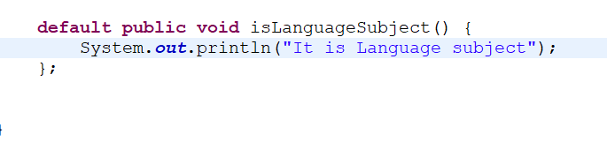
Java Interface –Default Method
For creating a default method in Java Interface we need to use “default” keyword with the Method Signature .

Slide 4
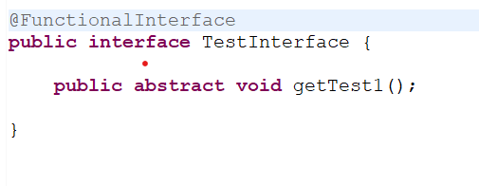
Functional Interface
What is Functional Interface?
If an interface contains only one abstract method ,that is known as Functional Interface.
Functional Interface is also known as SAM (Single Abstract Method).
@FunctionalInterface Annotation is used at top of Interface

Slide 5
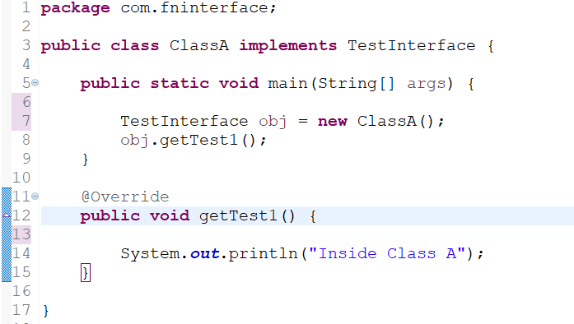
Different Ways to Implement Functional Interface
Using Implements Keyword

Slide 6
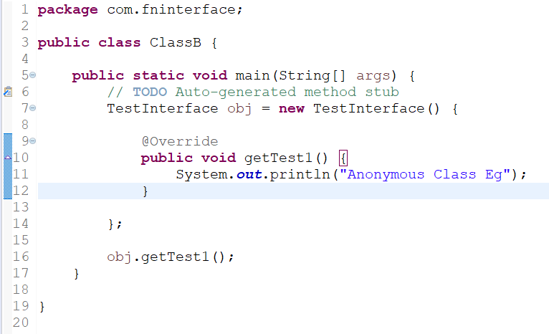
Different Ways to Implement Functional Interface
Using Anonymous class

Slide 7


Different Ways to Implement Functional Interface
Using
Lambda Expression

Slide 8
Lambda Expression
What is Lambda Expression?
Lambda Expression is a structured way to implement Functional Interface
Lambda Expression makes code more readable and stylish.
Lambda Expression has basically 3 parts as shown below
() -> {}
(parameter list) (Arrow/Lambda Operator) (function body)

Slide 9
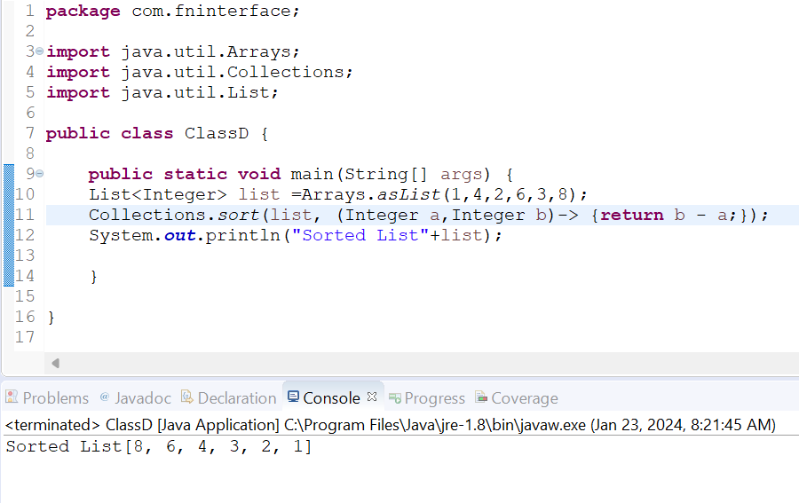
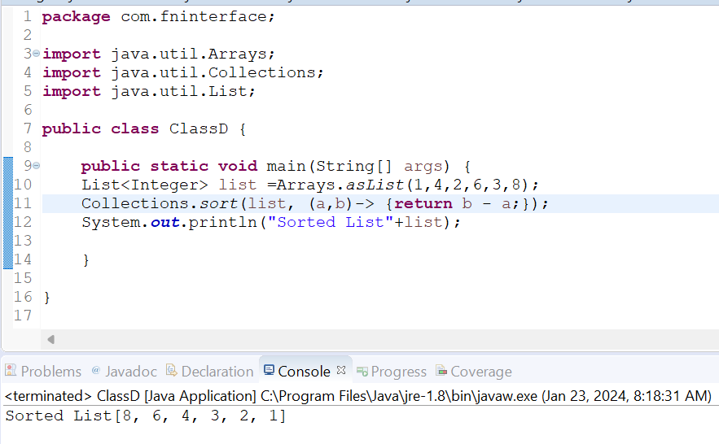
Lambda Expression –Type Checking
Specifying Type of Parameter
Without Specifying Type Of Parameter

Slide 10

THANK YOU!!!

